Slide 1
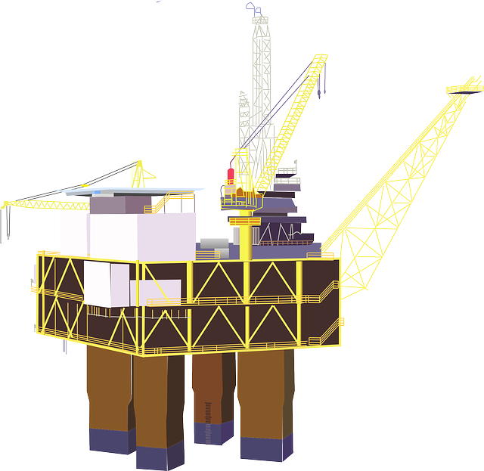
ENERGY EXPLORERS

Slide 2
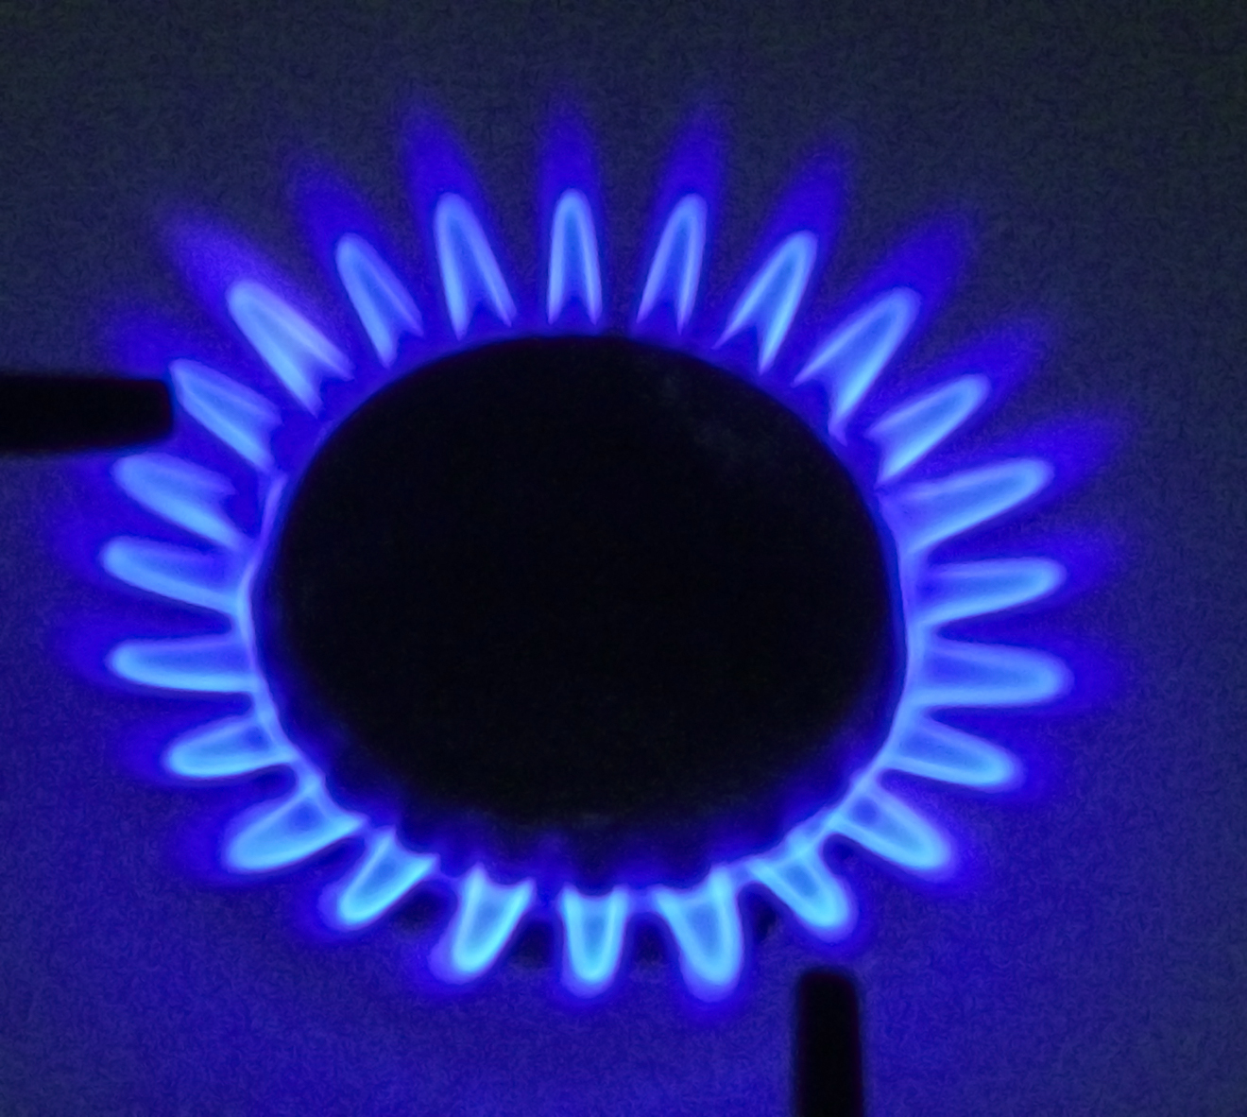
What is a fossil fuel?
Oil
Coal
Gas

Slide 3
Energy Explorer Task 1:
1. Make a table on a sheet of paper, with three columns.
2. Label each heading: Coal, Oil and Natural Gas.
Coal
Oil
Natural Gas
3. In each column write as many things as you can that use coal, oil and gas to fuel them.
3 minute challenge

Slide 4
WHERE DO FOSSIL FUELS COME FROM?
Fossil fuels are made from the burial of plants, animals and organisms from millions of years ago.
This means that fossil fuels are NON-RENEWABLE.

Slide 5
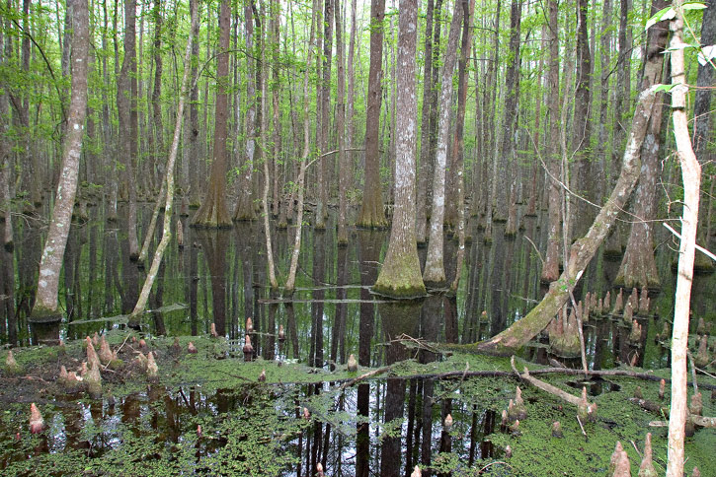
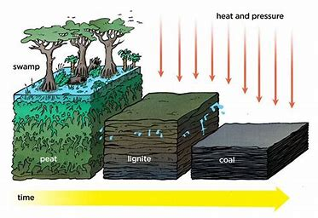
Coal was formed in places like this, around 300 million years ago!

Slide 6
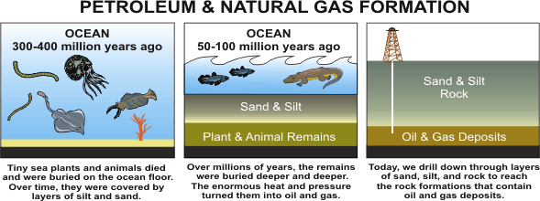
Oil and gas were formed in places like this millions of years ago!

Slide 7
HOW DO WE GET FOSSIL FUELS OUT OF THE GROUND?
2 MINUTE DISCUSSION

Slide 8
Why are fossil fuels important?
It’s time
for a film!
https://bpes.bp.com/fossil-fuels-resources

Slide 9
Coal helps to make lots of useful things:
Medicines
ELECTRICITY
Steel
Plastics
Dyes
Beauty products
Cleaning products

Slide 10
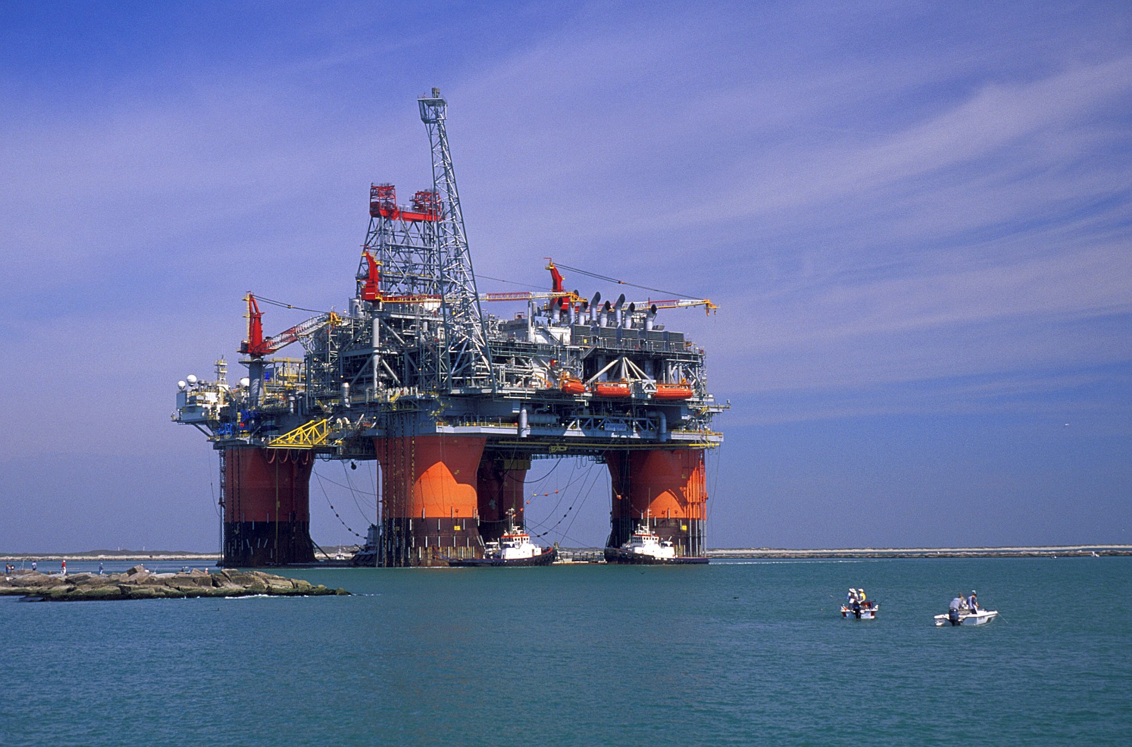
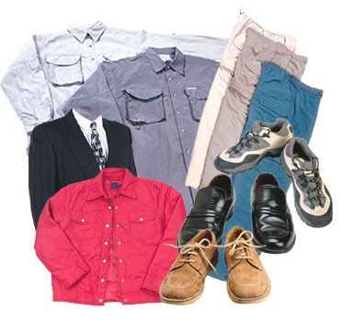
Oil and Gas are very useful:
Oil and gas are fuels. They give off heat when they are burnt.
Oil can also be made into LOADS of things.

Slide 11
Energy Explorer Task 2: CLASSROOM EXPLORATION
1. Take a tour of the classroom and continue the list of objects and items that use fossil fuels for energy, or to make them.
Coal
Oil
Natural Gas
The lights – use electricity
Oil used to make…
2. In each column write as many things as you can that use coal, oil and gas to fuel them.

Slide 12
What’s the link with air pollution?

Slide 13
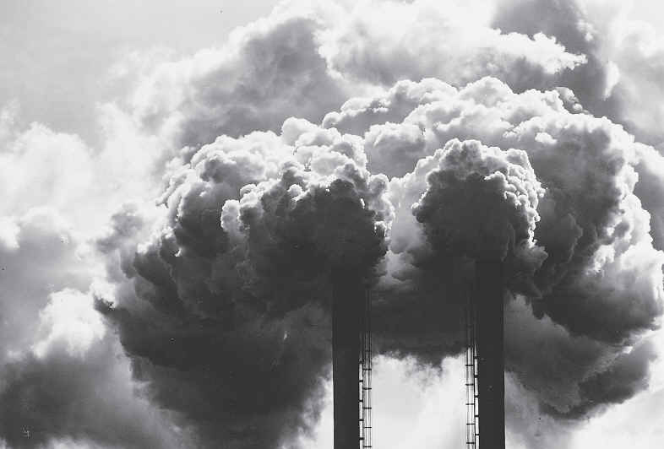
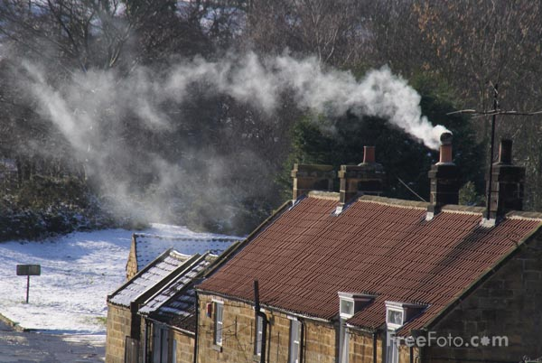
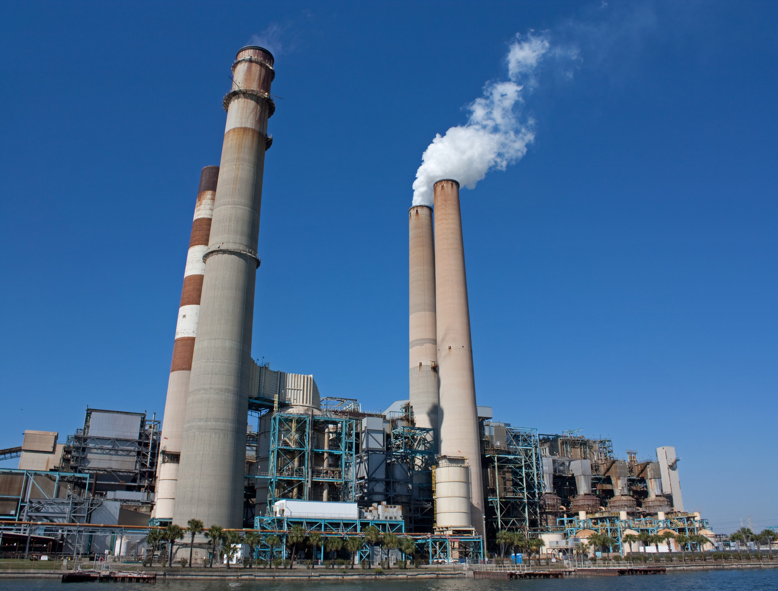
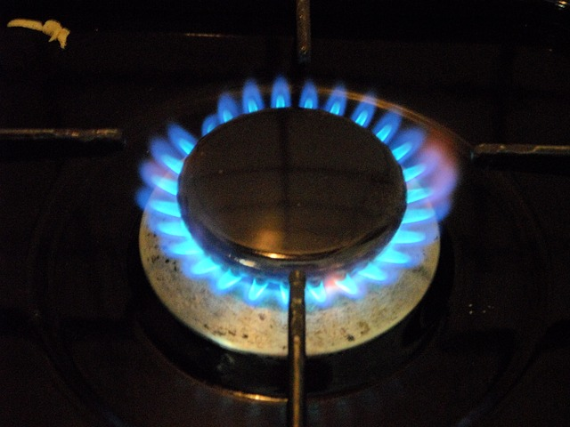
Burning fossil fuels causes air pollution…
Air pollution is caused by harmful pollutants being released into the air we breathe.

