Slide 1
Main title How do we monitor air quality?

Slide 2
Aim of the session
To understand how we monitor air quality in Leicester
Lesson objectives
To plot line graph data
To identify trends in data and potential anomalies
To evaluate reliability of data

Slide 3
Why monitor air quality?
Air pollution occurs when the amount of certain pollutants exceed recommended levels
The main ones of concern are nitrogen dioxide (NO₂) and fine particulates (PM_{2.5})
Guidance is set in law and the city council has a legal statutory obligation to meet them

Slide 4
Why?
In line with most major cities, Leicester previously exceeded statutory guidelines of 40μg/m3 for nitrogen dioxide (NO₂) in several areas of the city
The majority of pollution comes from road traffic emissions along major routes into the city (over 29,000 daily commutes into the city in 2014)¹ with the average commuting distance being 6 miles²
This is of major concern for those living on these routes
Notes:
1. Leicester City Council Traffic Cordon Survey 2014
2. Office for National Statistics: www.ons.gov.uk/ons/rel/census/2011-census-analysis/distance-travelled-to-work

Slide 5
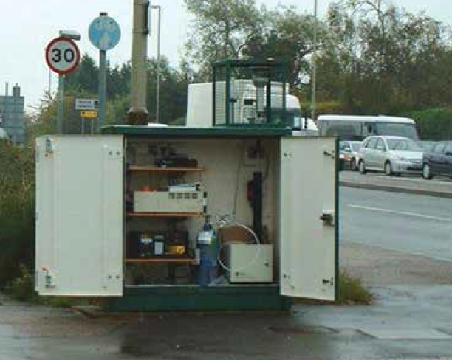
How do we monitor air quality?
We operate five automatic air quality monitoring stations
They measure nitrogen dioxide and particulate matter
They are located in areas of high traffic density therefore giving true records of air quality

Slide 6
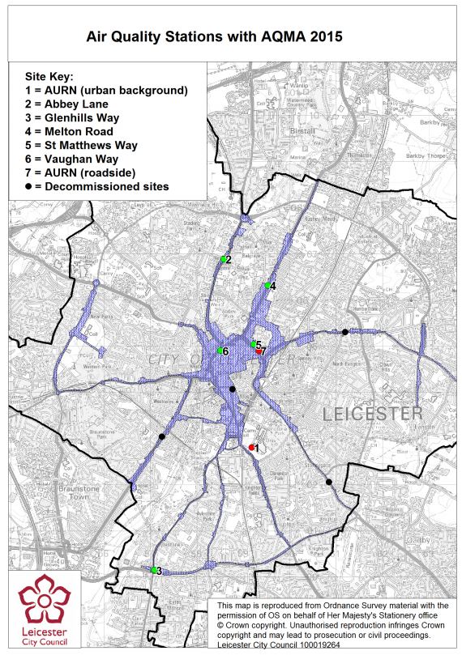
How do we monitor air quality? - continued
As well as the 5 stations monitored by the city council there are 2 Automatic Urban and Rural Network (AURN) stations
AURN stations provide high resolution hourly information communicated directly to the public
Monitoring allows us to check if we are meeting our air quality objectives and ensure we review and assess our air quality management plan

Slide 7
Where does NO₂ come from?
The majority of nitrogen dioxide comes from road traffic (80%)
Smaller amount come from domestic and commercial (15%) e.g. heating
Industry contributes the least (5%) e.g. major factories

Slide 8
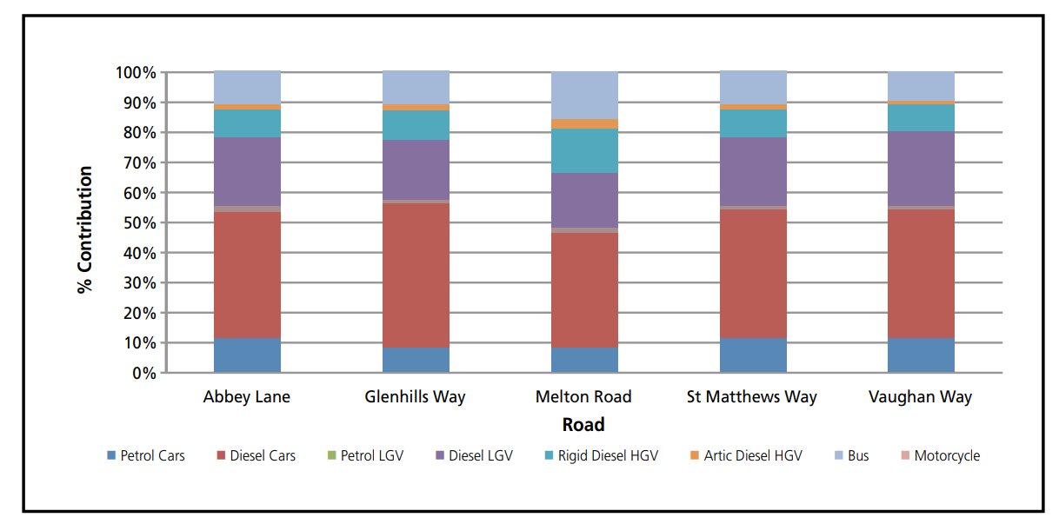
Where does NO₂ come from? -Continued
Which vehicles produce the highest NO₂ contributions?
Why might the figures be different on different roads?

Slide 9
Annual NO₂ levels at different stations
Annual mean not to exceed 40µg/m³

Slide 10
Annual NO₂ levels at different stations -Continued
What are the general trends in the data?
Why do you think there are differences in the readings?
Annual mean not to exceed 40µg/m³

Slide 11
Particulate data (PM₁₀) - annual
Using the particulate (PM₁₀ data) annual
Graph the data (using excel or by hand)
Look at trends
Identify an anomalies
Identify what you would do next?

Slide 12
Particulate data (PM₁₀) – annual - continued
Annual mean not to exceed 40µg/m³

Slide 13
Particulate data (PM₁₀) - annual - continued
PM₁₀ figures are generally decreasing
All of the latest figures are under the requirement of 40µg/m³
Between 2006 there was a decrease, but then by 2011 had returned to the previous figure
Any other patterns?
Annual mean not to exceed 40µg/m³

Slide 14
Particulate data (PM₁₀) – 24 hour mean
Now using the particulate (PM₁₀ data) 24 hour mean
Graph the data (using excel or by hand)
Look at trends
Identify an anomalies
Identify what you would do next?

Slide 15
Particulate data (PM₁₀) – 24 hour mean - continued
PM₁₀ mean figures are generally decreasing
Peak figures often go over the requirement of 50µg/m³ however, not very often per year
Why might it peak in a 24 hour period?
24 hour mean not to exceed 50mg/m³

Slide 16
Extension/homework activity
Using your data, write a letter to your local MPs and/or councillors to describe what you have found out and what you people should do
Design a campaign which could be used in school to raise awareness of the issues
Use the AURN website to look at data trends in similar cities to Leicester, do they have similar patters or different?

