Slide 1

Get inspired to take your lessons
outdoors with our numeracy and literacy lesson plans for each KS1 and KS2 year group.
Lesson plans have been designed to:
Link to the national curriculum
Work in any school grounds
Use commonly found natural materials
Need minimum preparation time
Twilight training sessions
Confirmed locations and dates:
Marriot Primary School – Tue 11 Sep and Tue 18 Sep, 3:30 – 5pm
Mellor Primary School – Tue 25 Sep and Tue 2 Oct, 3.30 – 5 pm

Slide 3

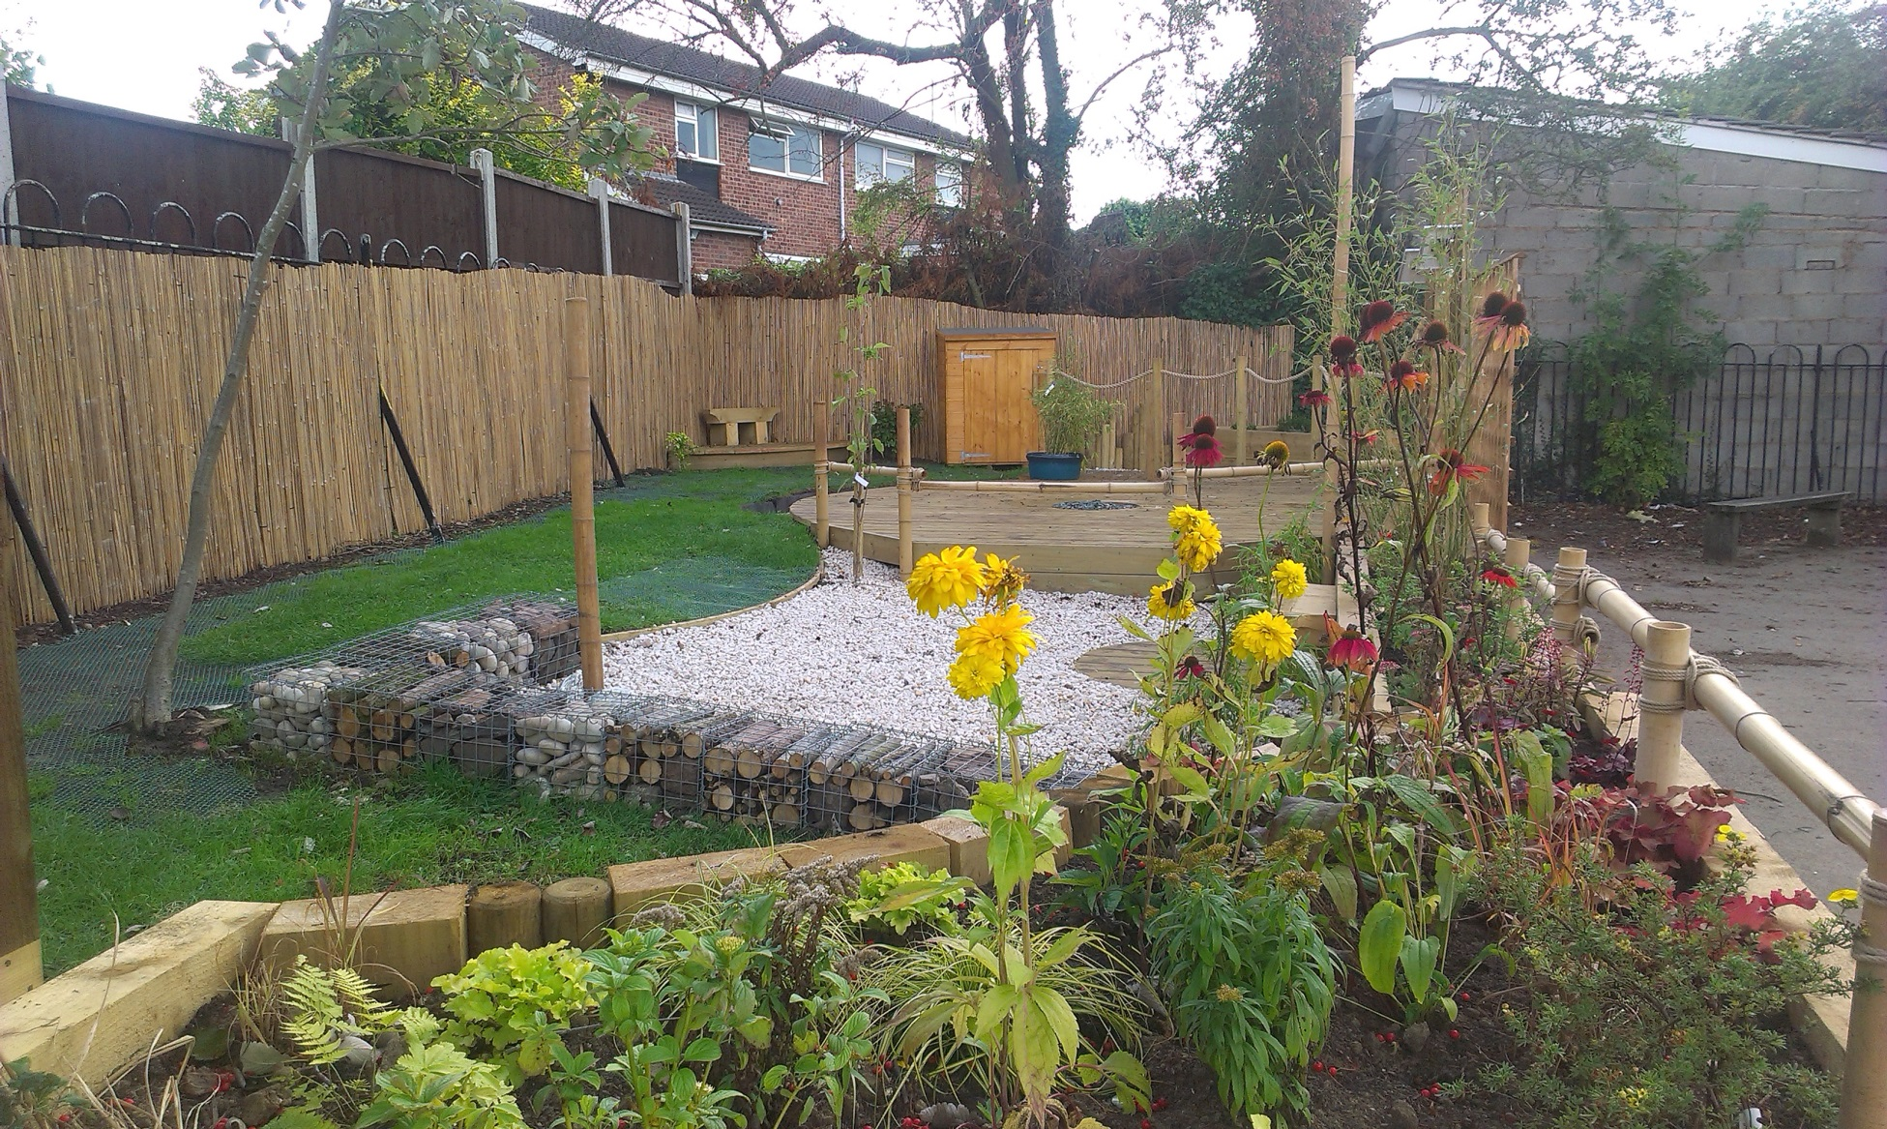

Slide 4
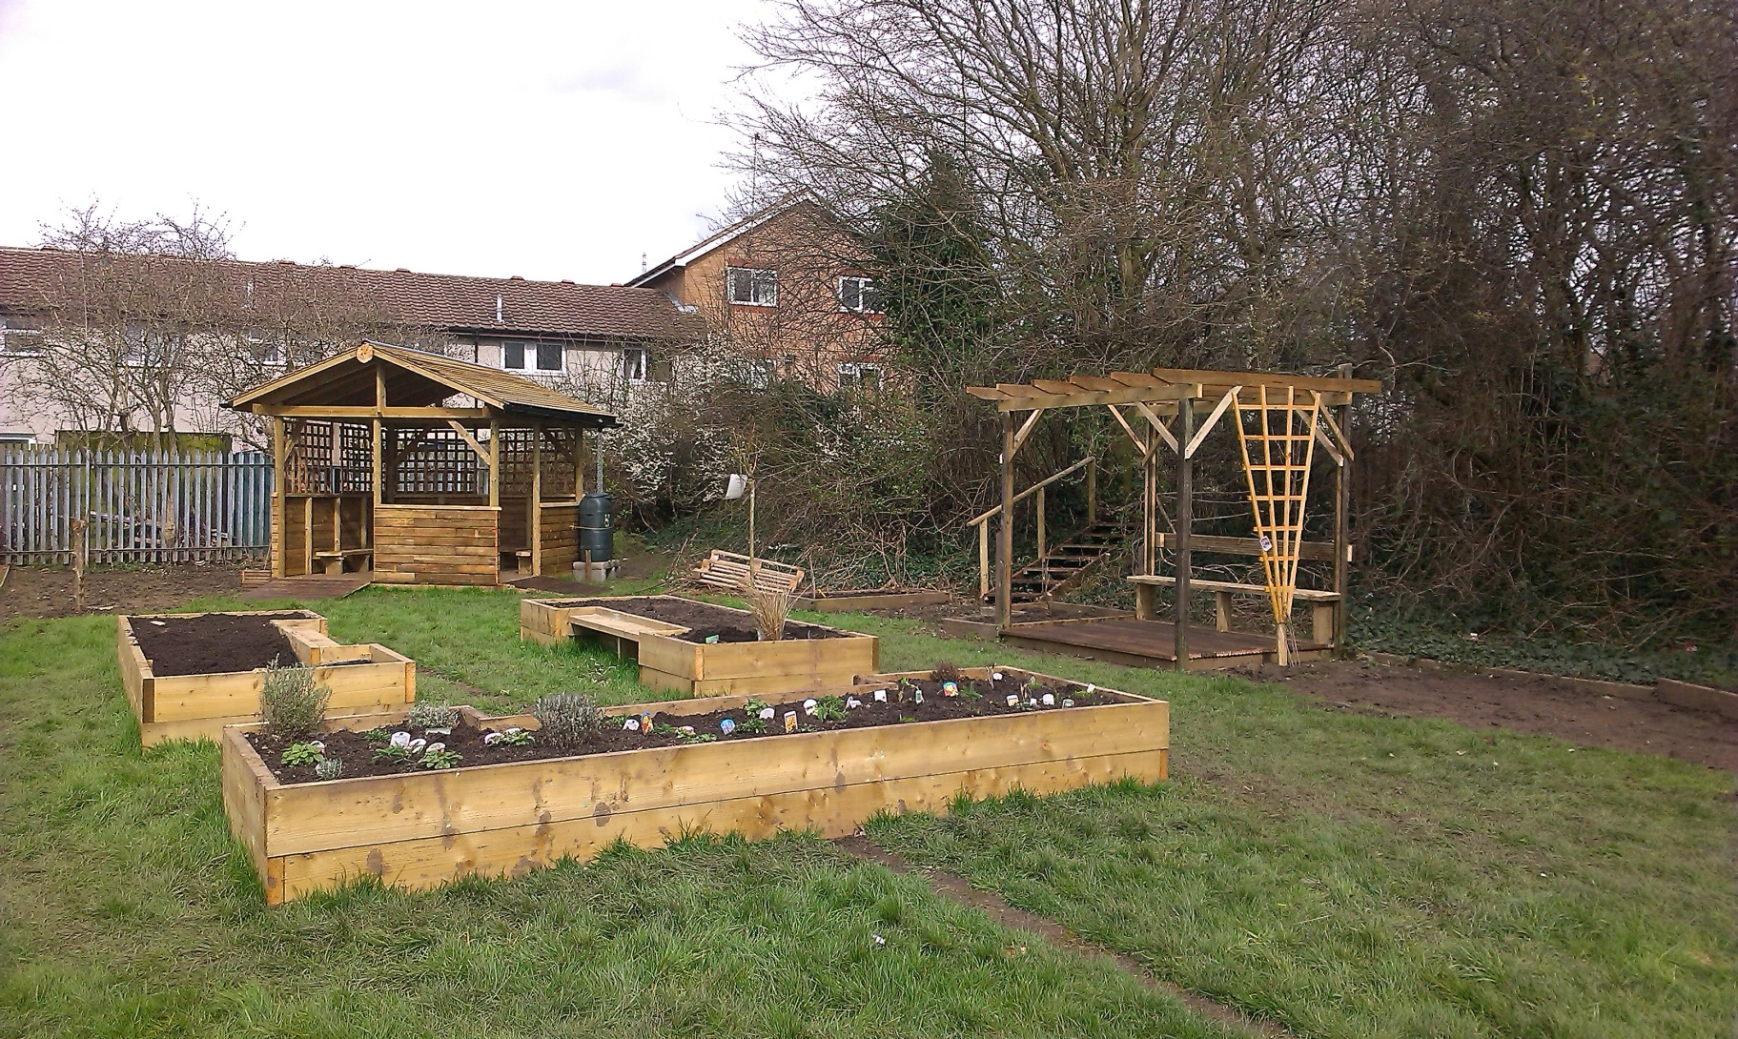
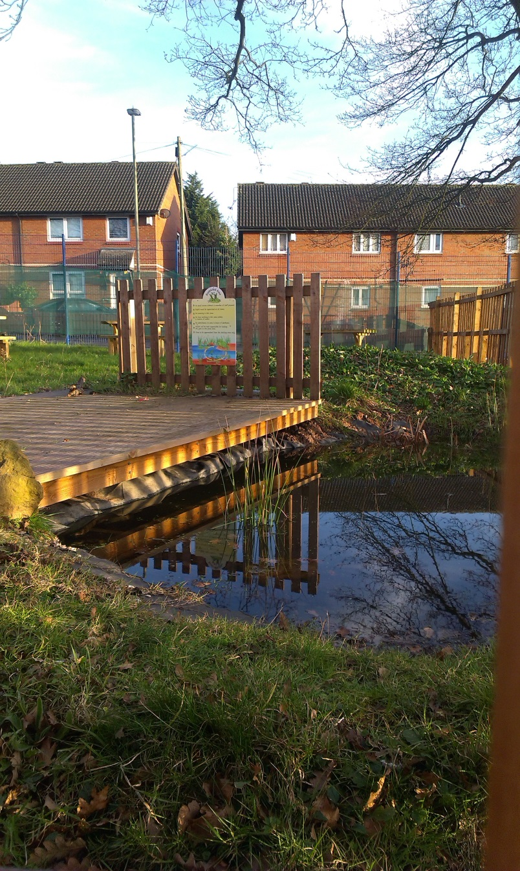
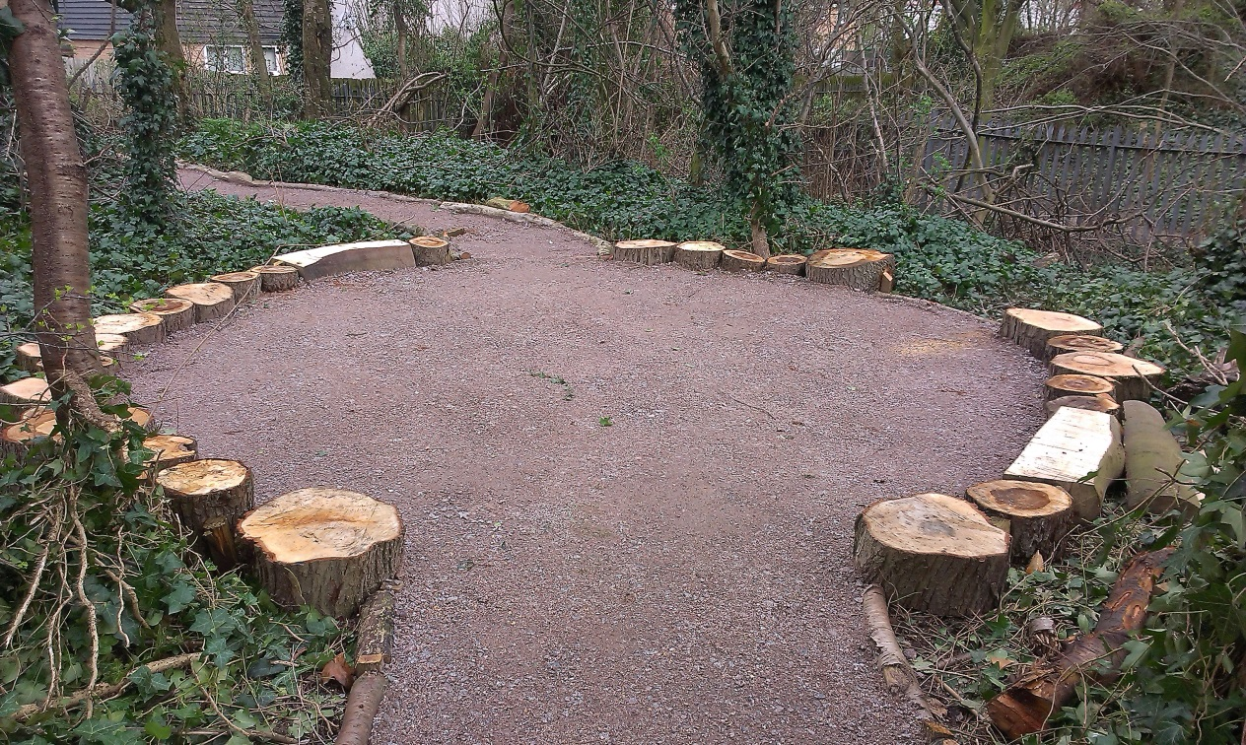

Slide 5


Download a pack: www.wildlifetrusts.org/30DaysWild/Downloads

